Slide 1


Getting started with Microsoft Bot Framework and Azure Bot Services
@
/in/

Slide 2
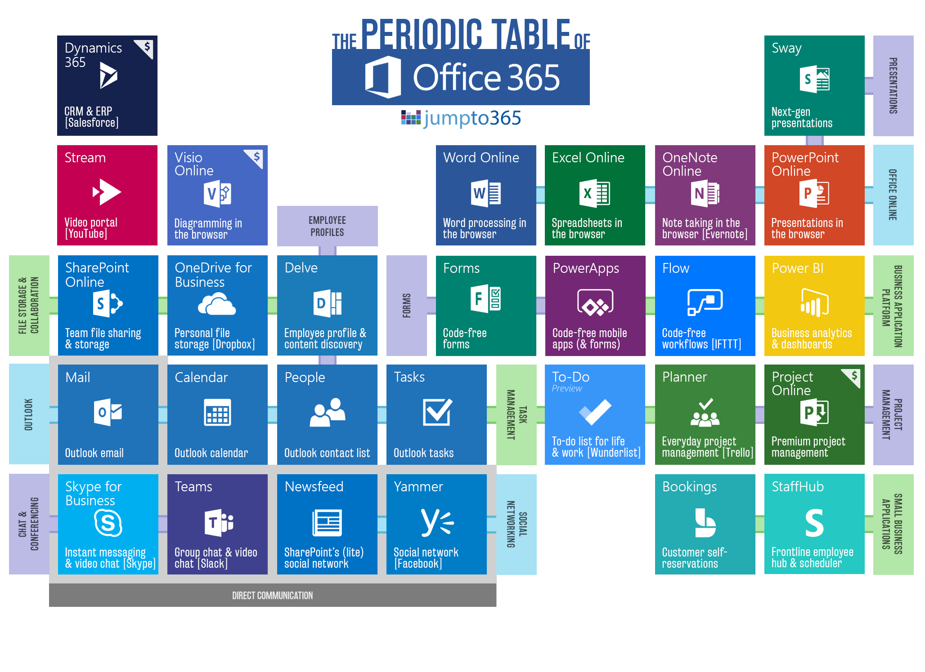

Slide 3
Build a bot (SDK v4.0)
Agenda
1
2
Connect to an FAQ KB
3
Best practices & architecture

Slide 4
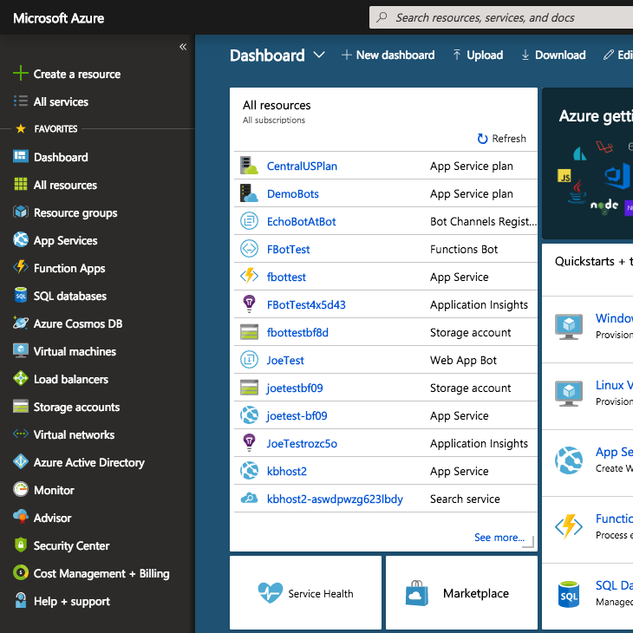
Creating a bot has become super easy
Browse to portal.azure.com

Slide 5
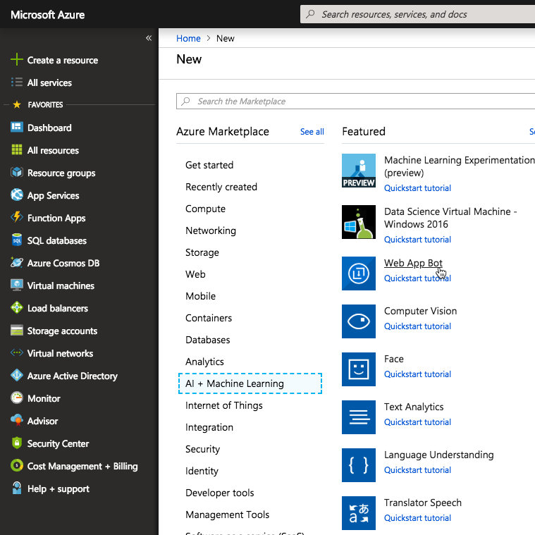
Deploy your bot from the Azure Portal
Create a resource > AI + Machine Learning > Web App Bot
Requires an Azure subscription. Register a free trial to get started.

Slide 6
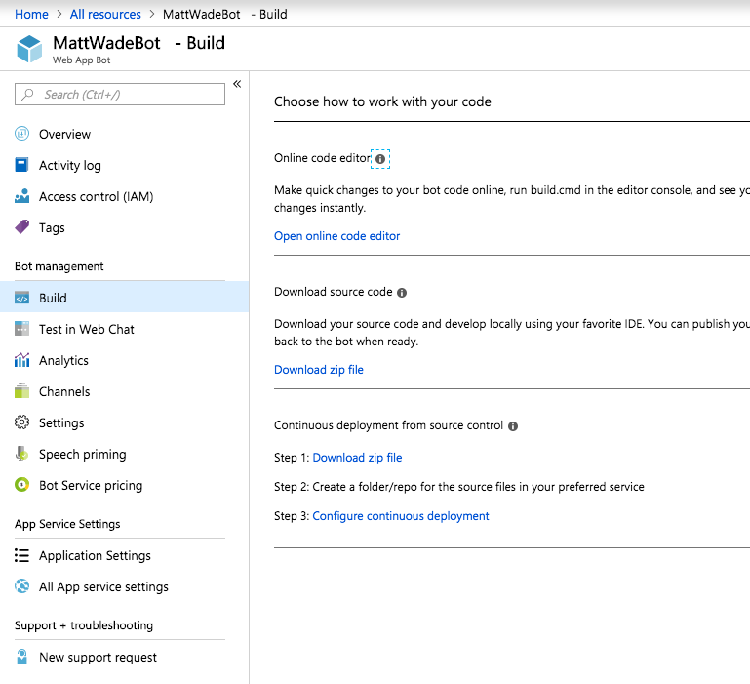
Create your bot
Add your code in the web editor or download the ZIP to work in Visual Studio.
You’ll do most work in MessageController.cs or RootDialogue.cs

Slide 7
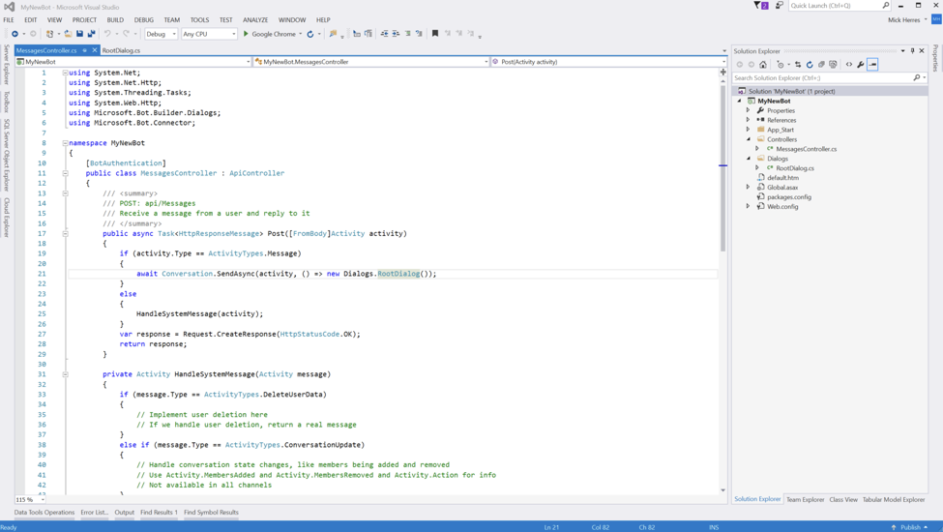

Slide 8
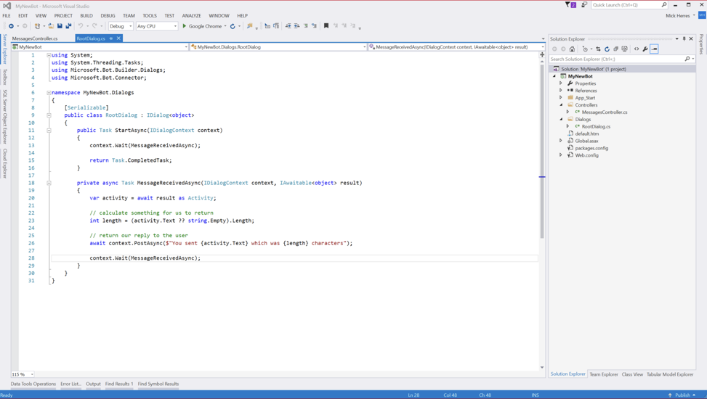

Slide 9
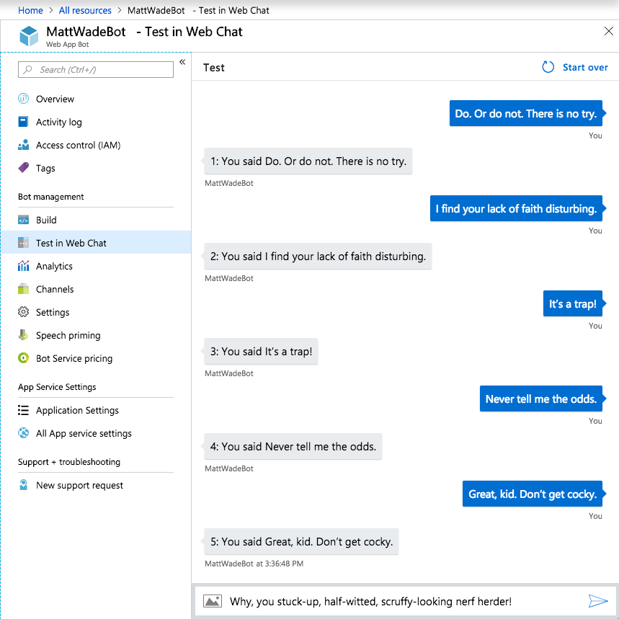
Run tests in online or local emulator
Bot Dashboard > Test in Web Chat

Slide 10
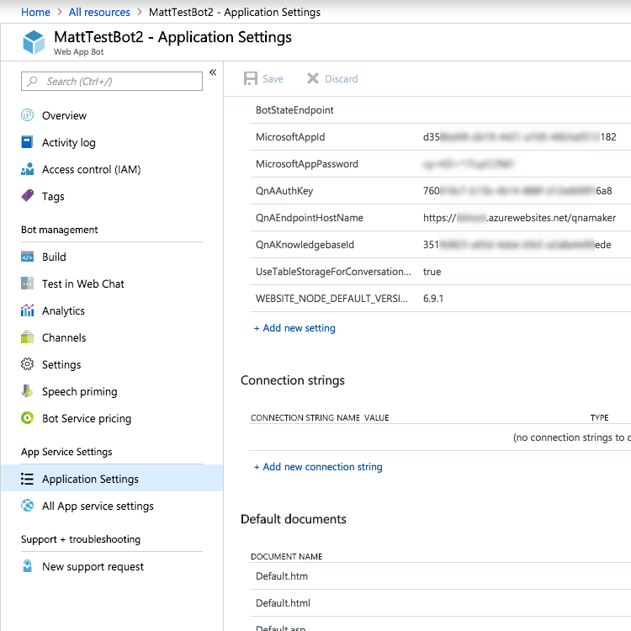
Connect to QnA Maker
Instructions:
icsh.pt/CreateQnABot
QnA Maker best practices: tinyurl.com/AtBotQnABP

Slide 11
Let’s build a bot

Slide 12
Best practices & architecture

Slide 13





A good bot stands on three legs
🤖
Bot Services
Bot Framework
LUIS
Know
Understand
QnA Maker
Node.js/C#
Do

Slide 14

Don’t fall into the trap
A good FAQ bot is not good enough

Slide 15
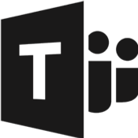
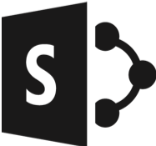




Surfacing your bot
Internal
(Authenticated)
External
(Public)
Teams
SharePoint
Intranet
Custom
(Direct Line)
Website
Social Media
Custom
(Direct Line)

Slide 16
Demo https://youtu.be/wAPcafOL_tg

Slide 17


Slide 18
Demo https://youtu.be/EWXBYDQ4TVQ

Slide 19
Some resources
Azure Bot Service Documentation: https://icsh.pt/BotServiceSDK4
Create a QnA bot: https://icsh.pt/CreateQnABot
Getting started with the Bot Framework (video): https://youtu.be/cumYtCVjl6Q
Incorporating LUIS (Natural Language Processing): https://tinyurl.com/AtBotLUIS
QnA Maker best practices: https://tinyurl.com/AtBotQnABP
Getting started with code-free, Microsoft Flow bots: https://icsh.pt/NoCodeBots

